Slide 1

Project Presentation
Intro of Network Science
Tools: Python
Zhihao Wang

Slide 2
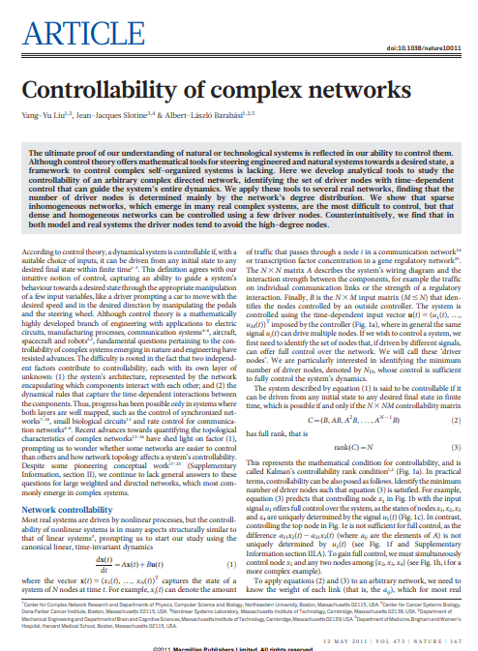
Paper Selection
Title: Controllability of complex network
Authors: Liu Yang-Yu, Jean-Jacques Slotine, Albert-Laszlo Barabasi

Slide 3
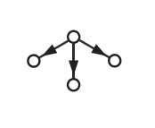
Paper background
The study of controllability is about how the whole system can reach any desired state from any initial state.
If some nodes in the network can not be arrived spontinously, it will make the diagram not completely controllable.

Slide 4
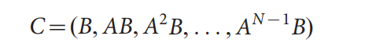
Paper background
Kalman’s controllability matrix, which is a
method of judging: if the condition of Kalman matrix is satisfied by
the network is called structurally controllable.
Limits:
1) the weight of all matchings in networks needs to be known
2) formula requires time complexity less than 2^n-1, in which most real nets are typically larger.
Liu succeed in introducing a new method combining graph theory to determine the controlability of more complex real networks.

Slide 5
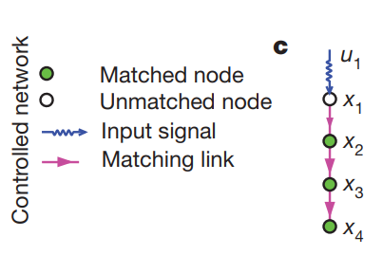
Matching
According to the graph theory, matching means the edges without common vertex.
By defining nd, the number of minimum driver nodes to control the network, as the judging basis, Liu has been able to prove the controlability can be determined by 'maximum matching’.
When the net is arriving at its max matching, unmatched nodes will be equal to the minimum inputs required to control the network

Slide 6
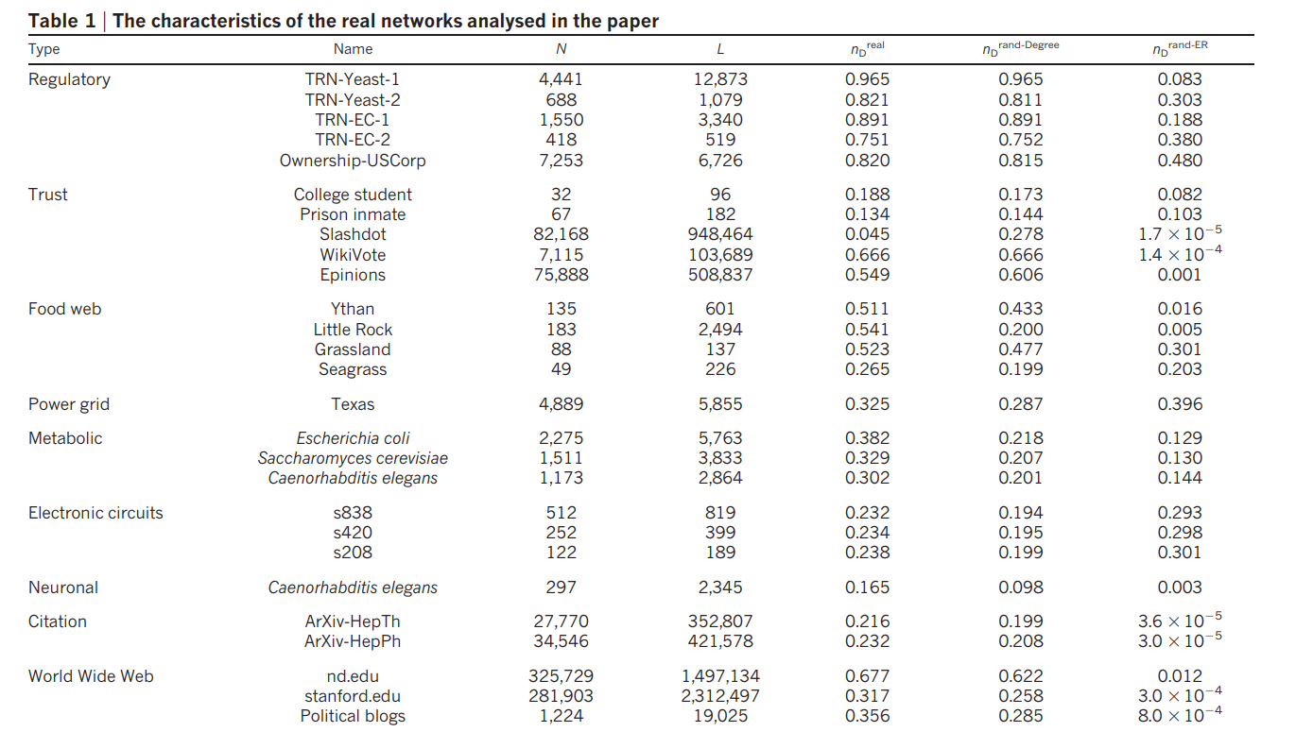

${n_{D}}^{rand Degree}$:
the density of
driver nodes with random degree
${n_{D}}^{rand ER}$:
the density of
driver nodes in ER randomlization

Slide 7
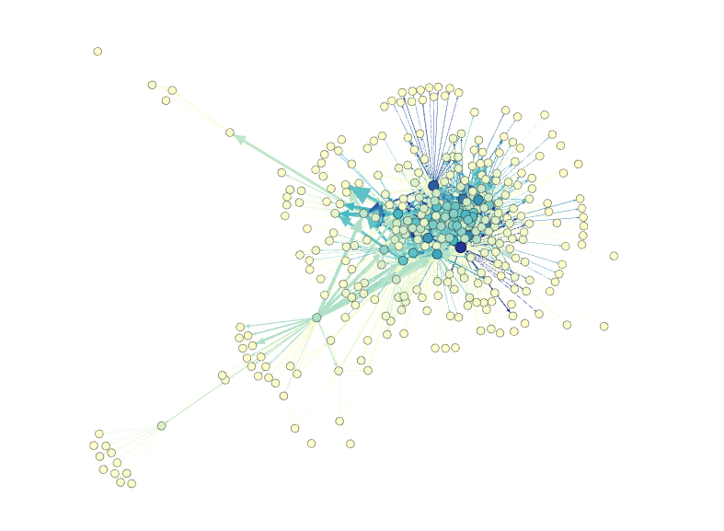
Yeast
Directed network with 332 vertices and 2126 arcs
Diameter : 6
Average degree: 4.042

Slide 8
Network Analysis
algorithm
1. analyize the network using Gephi
2. generate random degree network to keep the degrees, kin/kout of each node unchanged but selects randomly the nodes that link to each other.
3. generate ER random network based with same N and same expected L
ER possibility: 0.039
expected arcs: 2131
4. using nx.bipartite.Maximal_matching() to achieve max_matching and count the ND value among these three networks
5.
5. to get the density

Slide 9
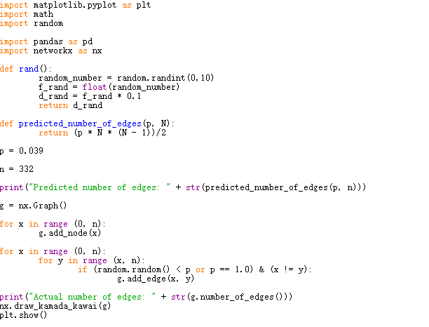
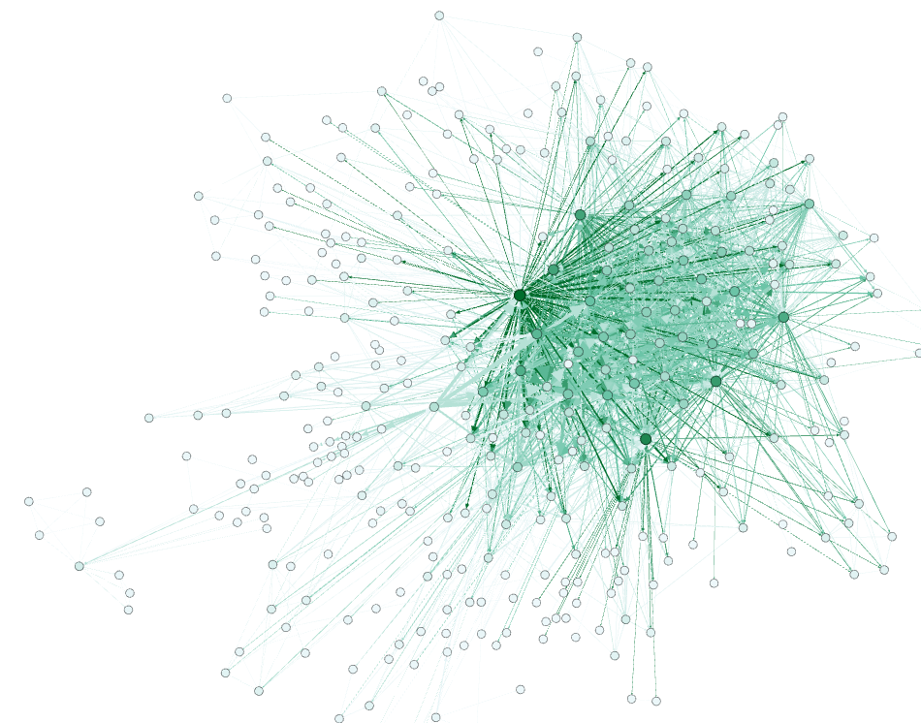

Slide 10
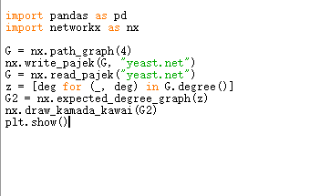
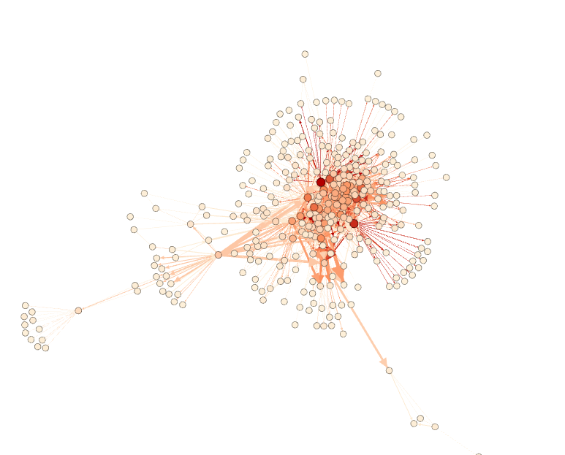
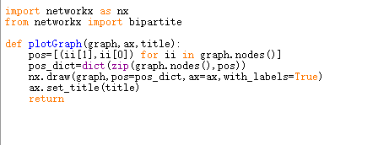

Slide 11
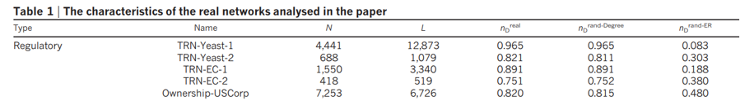
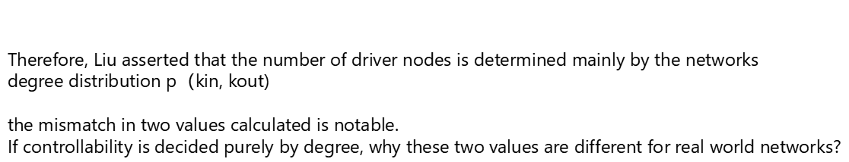
Result and evaluation
N | L | $${n_{D}}^{real}$$ | $${n_{D}}^{rand Degree}$$ | $${n_{D}}^{rand ER}$$
332 | 2126 | 0.375 | 0.367 | 0.128
$${n_{D}}^{rand Degree} and {n_{D}}^{real} shows similar values.$$
Therefore, Liu asserted that the number of driver nodes is determined mainly by the networks
degree distribution p（kin, kout)
the mismatch in two values calculated is notable.
If controllability is decided purely by degree, why these two values are different for real world networks?

